Slide 1
SSD: Single Shot MultiBox Detector
Victor W. Wang

Slide 2
Contents
Status quo (as of 29. dec 2016)
SSD:
Architecture and innovations
Training method and data augmentation
Results & analysis
Comparison vs. other NNs
Conclusion

Slide 3
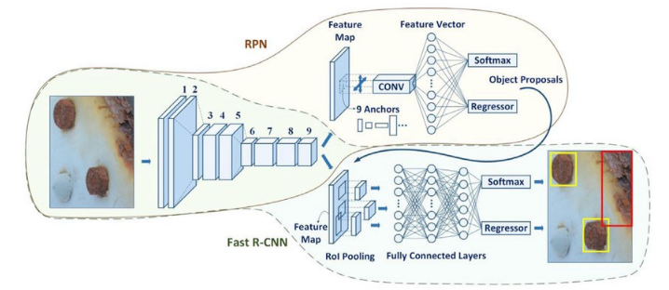
Status quo
SotA networks (YOLO, Faster R-CNN, etc)
Region proposal Faster R-CNN (
Resampling
Last layer(s): fully connected
Tradeoffs: speed vs. accuracy
SSD: no tradeoff, only improvements

Slide 4
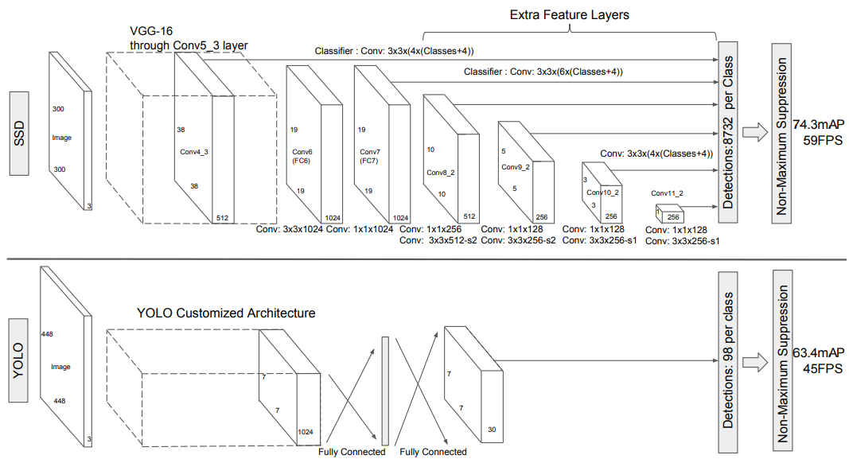
SSD: Architecture and innovations
VGG-16 base for layers 1-5, pretrained on ILSVRC CLS-LOC
Add feature maps at different scales, make predictions from these
Conv. predictors for detection instead of fully connected
(c+4)*k*m*n outputs for a given scale
NMS to filter low confidences
Single shot detection like YOLO

Slide 5
SSD: Architecture and innovations
À trous convolution in pool5 layer to fill holes caused by 3x3 kernel in pool5’s sampling

Slide 6
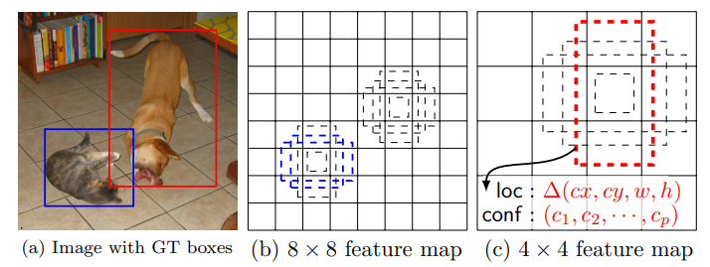
SSD: Architecture and innovations
Default boxes for bounding box estimation:
M different scales from 0.2 to 0.9, yielding M feature maps
≤ 6 aspect ratios per feature map location
Regression for offsets across all boxes

Slide 7
SSD: Design and innovations

Slide 8
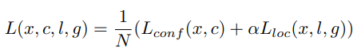
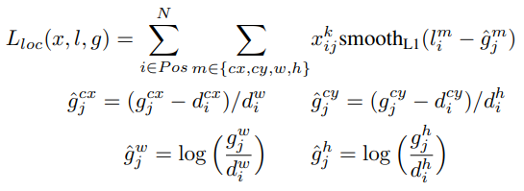
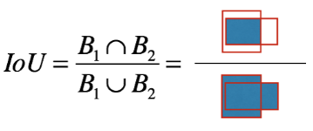
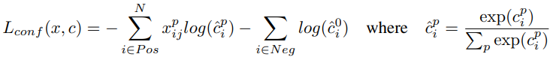

SSD: Training method & data augmentation
Versions: [512x512] & [300x300] (faster) pixel resolution
Ground truth assigned to feature maps of appropriate scales
Box matching: Intersection over Union
Loss function derived from MultiBox
Localisation $L_{loc}$: Smooth L1
Classification $L_{conf}$: Softmax

Slide 9
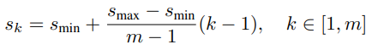
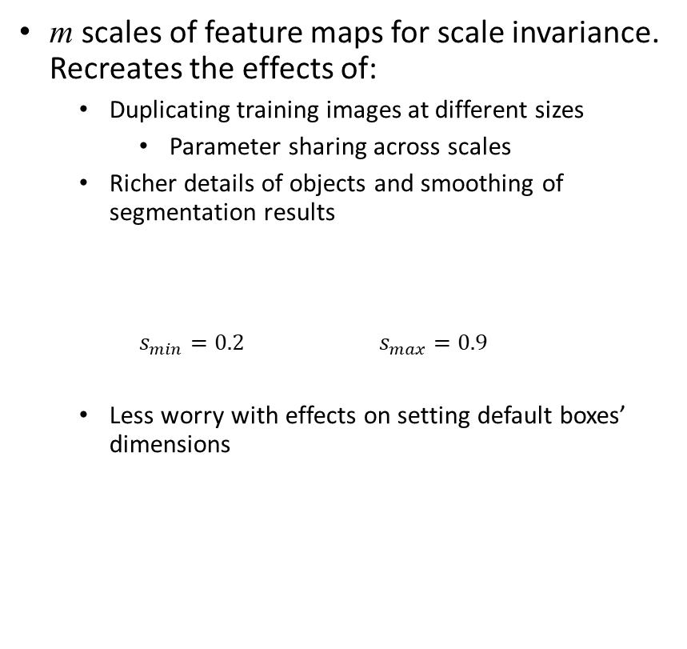
SSD: Training method & data augmentation
m scales of feature maps for scale invariance. Recreates the effects of:
Duplicating training images at different sizes
Parameter sharing across scales
Richer details of objects and smoothing of segmentation results
$s_{min}=0.2$ $s_{max}=0.9$
Less worry with effects on setting default boxes’ dimensions
Data augmentation
Sampling step (same probability):
Original image
Segment of image with objects, minimum IoU = 0.1, 0.3, 0.5, 0.7 or 0.9
Randomly sampled patch
Range of aspect ratio: [0.5, 2]; image size: [0.1,1]
50% chance to be mirrored
Hard negatives
Large num. of default boxes → mostly negatives
Sort negatives by conf., use at most N = 3x [objects] for backprop → faster/more stable training

Slide 10
SSD: Training & data augmentation

Slide 11
Results & analysis
Metrics
Correctness: Mean Average Precision (mAP)
Speed: FPS

Slide 12
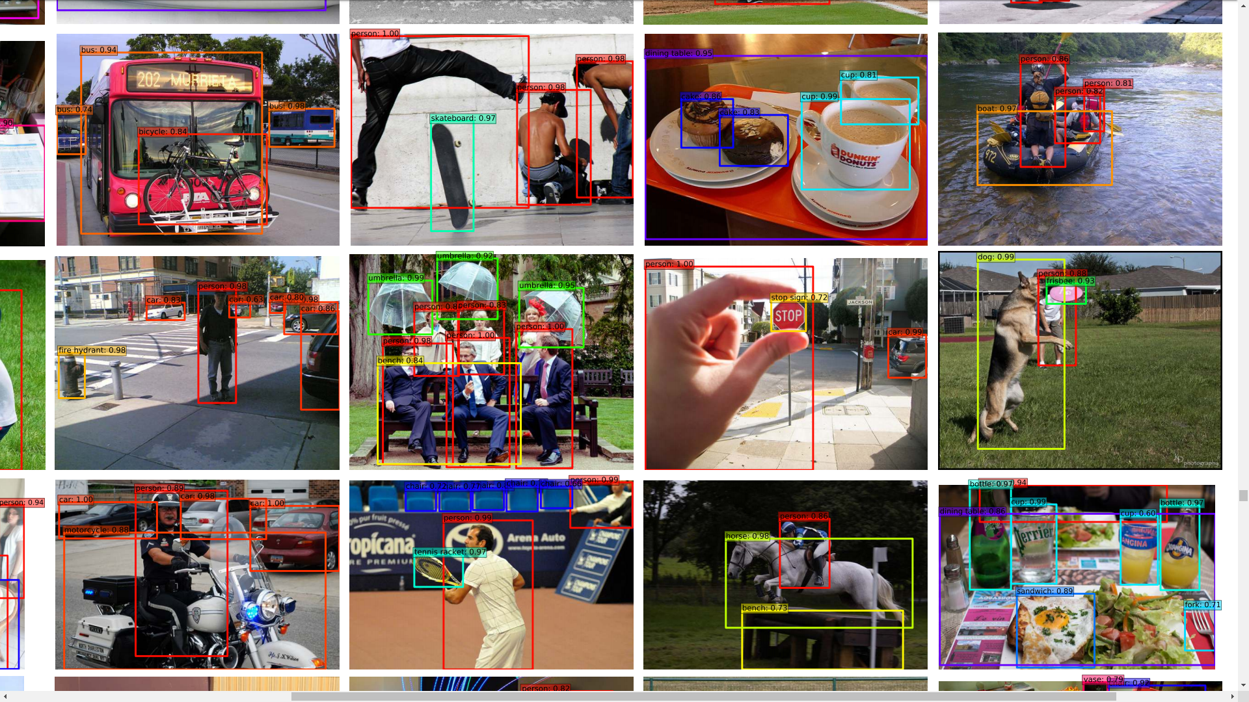
Results & analysis

Slide 13
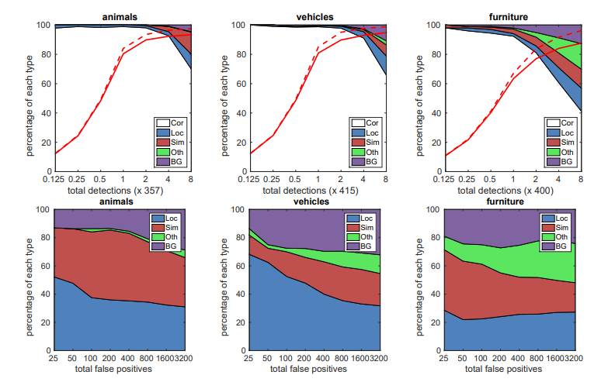
Results & analysis
SSD512 detection results on VOC2007 test set
- - - - - Recall at 0.1 IoU threshold
––––– Recall at 0.5 IoU threshold

Slide 14
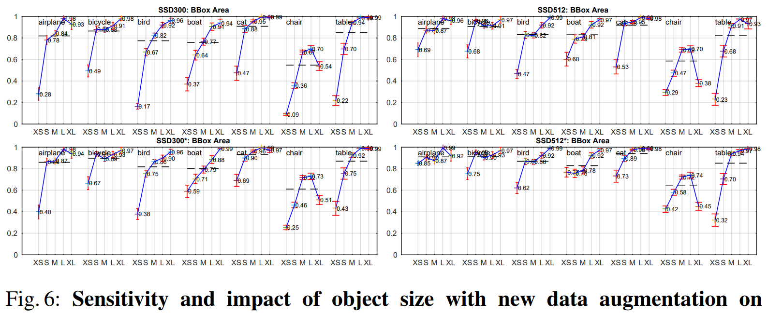
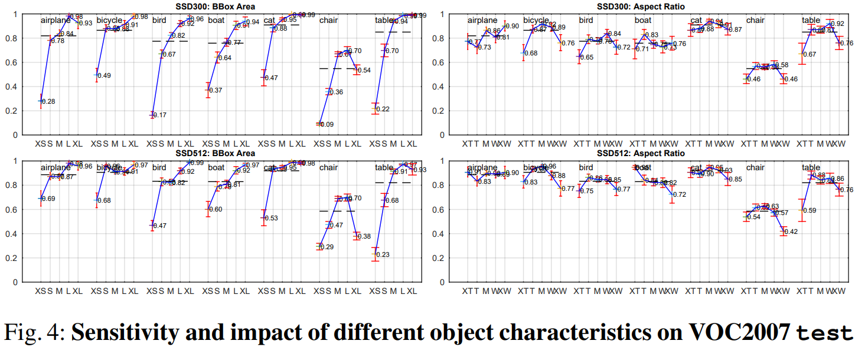
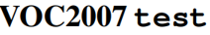
Results & analysis
x, y = aspect ratio, effect on learning

Slide 15
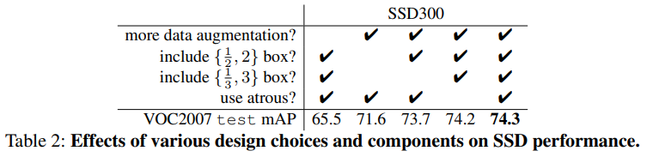
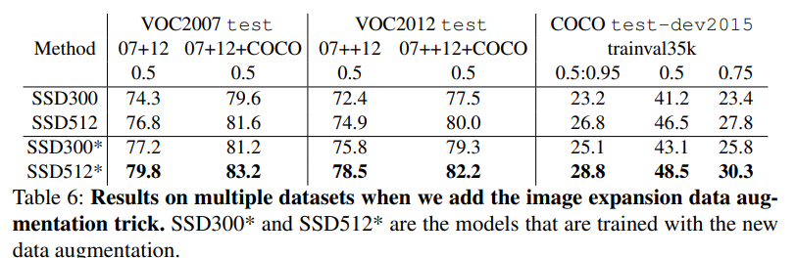
Results & analysis
Validating training methods

Slide 16
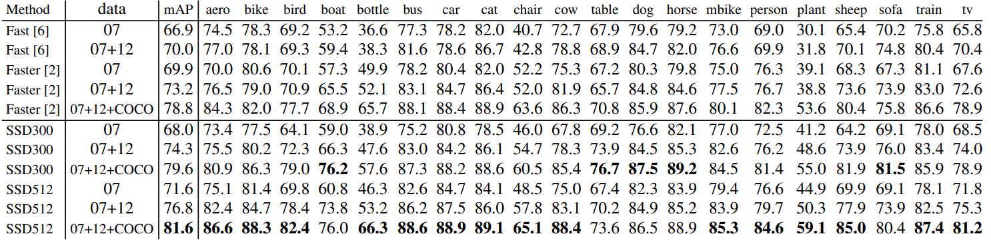
Comparison vs. other NNs
PASCAL VOC2007
SDD vs R-CNN versions. SDD clearly superior
SDD: sensitive to bounding box size. Better on larger objects

Slide 17
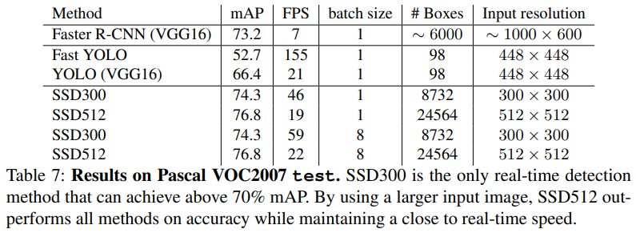
Comparison vs. other NNs

Slide 18
Conclusion
SSD: Single shot detection method
Multiscale feature maps & default bounding boxes
Far more predictions made compared to other methods
3x faster and clearly more accurate than SotA across different datasets
Important methods for optimising training

Slide 19
Sources
SSD paper https://arxiv.org/abs/1512.02325
Article about SSD https://towardsdatascience.com/review-ssd-single-shot-detector-object-detection-851a94607d11

